Slide 1
WELLS FARGO :
Fake Accounts Scandal
ENCP 6000
PRESENTATION

Slide 2
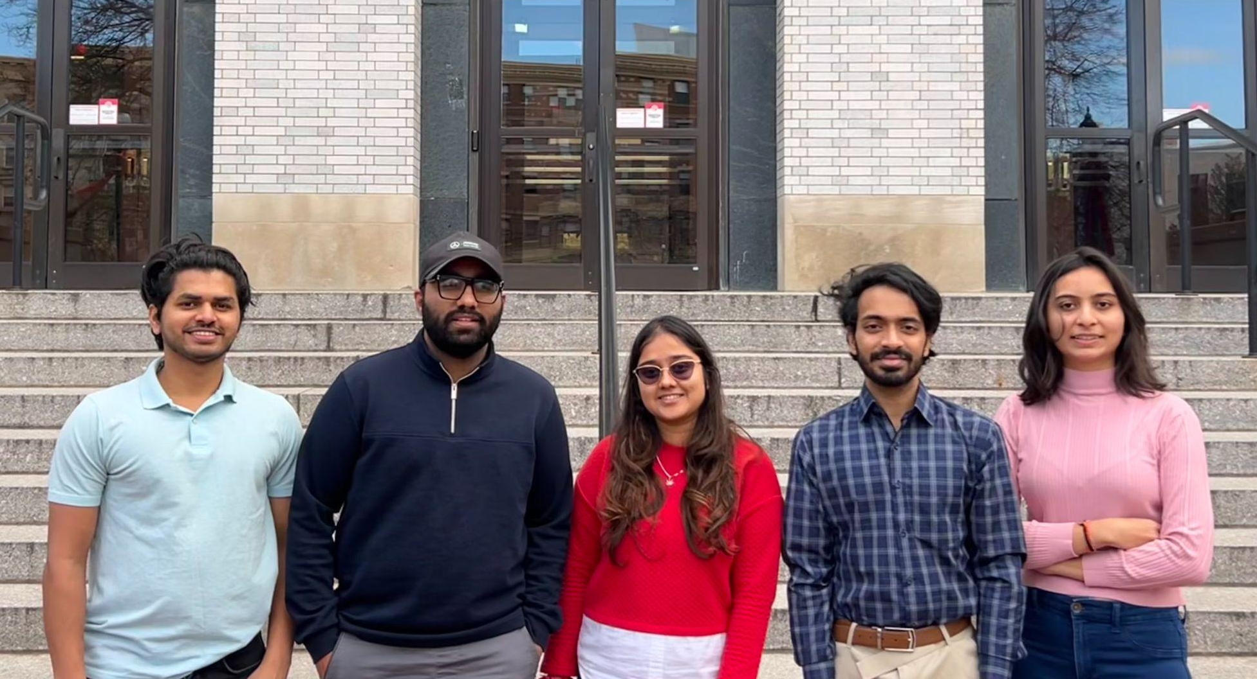
GROUP 10 : Team Members
Sourabh Kumar
Kabir Khanna
Hir Desai
Haresh Ramasamy
Esha Patel

Slide 3
BACKGROUND INFORMATION
Wells Fargo was the fourth-largest bank in the US by assets at the time
﻿﻿The company was founded in 1852 and had been in business ever since
Wells Fargo was an extremely reputed bank with a loyal customer base
On the 8th of September 2016, news went public that employees at Wells Fargo had created ghost accounts
﻿﻿It was found that fake accounts had been opened since 2011

Slide 4
MAIN ISSUE
Pressurized to meet sales targets, bank officials opened over a million savings and checking accounts in the names of actual customers without their approval
﻿The fraud became public in 2016, causing the bank to be buried numerous lawsuits
An astonishing 1.4 million fake accounts were created
﻿﻿A total of 3.5 million potentially fake bank and credit card accounts
﻿﻿The bank charged over 800,000 customers for insurance on car loans that the customers no longer needed
Post the scam Wells Fargo implemented a number of reforms and ethics based reforms to rise from the defamation

Slide 5
INTERESTING INFORMATION
Claudia Ponce De Leon
$100 million fine
Real account deletions
The silenced whistleblower
Largest penalty issued after the Great Recession
In an effort to correct their mistakes, several legitimate accounts were mistakenly deleted
Notes:
- At one point in 2015, Wells Fargo's CEO set a target of 8 accounts per household for cross-selling. This pushed employees to open unnecessary accounts to meet unrealistic quotas.
- Wells Fargo customers tried suing the bank for a variety of issues related to the fake accounts, including damaged credit scores, unauthorized fees, and wasted time trying to close unwanted accounts.
- Angry former employees alleged they were forced to work late nights and weekends to meet insane sales goals. One manager claimed she was demoted for refusing to push her team to break the law to hit targets.
- Wells Fargo branch staff nicknamed their aggressive sales tactics "sandbagging" - they would hold back a customer request until extensive sales pitches were made to the customer.
- The Consumer Financial Protection Bureau ordered Wells Fargo to pay $100 million in fines for the fake accounts. This was the largest penalty the agency had issued since it was founded in 2011 after the Great Recession.
- In emails sent to employees, Wells Fargo's CEO referred to the settlement as a "cost of doing business" leading to accusations that executives did not take the scandal seriously.
- Wells Fargo's board commissioned a report that found the bank's decentralized structure was a major factor allowing the unethical sales culture to spread rapidly across branches.
- Even after the scandal, whistleblowers alleged that Wells Fargo continued similar practices, leading to lawsuits claiming fraudulent sales activities were still ongoing.
- As part of reforms, Wells Fargo expanded its internal whistleblower hotline and tip program to allow employees to anonymously report unethical sales activities.

Slide 6
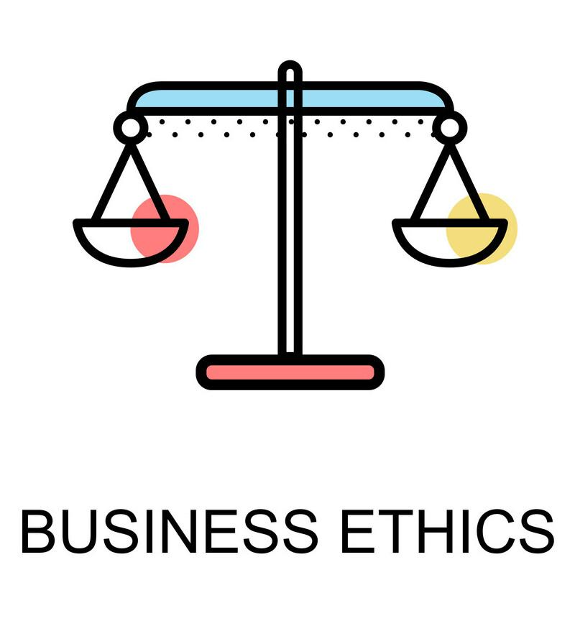
ETHICAL SIGNIFICANCE
Violation of Trust and Integrity
Example : Unauthorized credit card accounts impacting customer credit scores
Unhealthy Corporate Culture
Example : Employees creating fake accounts under pressure to meet sales targets
Failure in Leadership and Accountability
Example : Delayed action by executives despite early warnings

Slide 7
IMPACT
Regulatory Reshaping: How Wells Fargo's Missteps Reshaped Financial Oversight
From Water Cooler Whispers to Ethical Crossroads:How Wells Fargo's Blunder Sparked a Conversation on Ethics and Goals in Finance
From Paychecks to Pressure: Wells Fargo's Impact on Employees -The Unseen Struggles of Job Loss and Stress
Shattered Trust: How Wells Fargo's Scandal Reshaped Customer Relationships

Slide 8
CONSEQUENCES
February
2020
December
2022
September
2016
April
2018
August
2018
Paid $3 billion to settle criminal civil investigations by Justice Department and SEC into its aggressive sales practices from 2002 to 2016
Paid $2 billion to consumers and $1.7 billion in civil penalties for mistreating customers
Forced to pay $185 million in damages to the CFPB, OCC.
CFPB, and OCC ordered the bank to pay $1 billion in damages over auto insurance and mortgage lending practices
Justice department levied $2.1 billion fine for mortgage lending practices
1
2
3
4
5
2

Slide 9
CONCLUSION
Stemmed from unreasonable sales goals
Scandal revealed serious cultural issues
Major consequences, including fines, legal settlements, executive resignations, and reputational damage
Unethical business practices can be widespread and deeply ingrained even in large respected companies

Slide 10
REFERENCES
Wilowski, M. (2023,March 16). Timeline: Wells Fargo’s biggest legal settlements. Investopedia. https://www.investopedia.com/wells-fargo-timeline-7498799#:~:text=September%202016%3A%20Wells%20Fargo%20acknowledged,goals%20set%20by%20company%20leadership
Marsh, A. (2017, April 6). Wells may be forced to welcome back another whistleblower. American Banker. https://www.americanbanker.com/news/feds-may-order-wells-fargo-to-rehire-a-second-whistleblower
Harvard Law School Forum on Corporate Governance. (2019, February 6). The Wells Fargo Cross-Selling Scandal. Harvard Law School Forum on Corporate Governance. https://corpgov.law.harvard.edu/2019/02/06/the-wells-fargo-cross-selling-scandal-2/
Prentice, Chris, et al. “Wells Fargo to Pay $3 Billion to U.S., Admits Pressuring Workers in Fake-Accounts Scandal.” Reuters, Thomson Reuters, 22 Feb. 2020, www.reuters.com/article/us-wells-fargo-scandal-deal/u-s-authorities-to-announce-deal-over-wells-fargos-sales-practices-scandal-sources-idUSKBN20F2KN/

